Slide 1


Technical Analysis – Stocks vs Crypto
Group 3: Project 1
Raelyn Sangil (Project Lead), Kurt Cullerton, Ramon Lee, Parvinder Rakhra

Slide 2
Overview
The purpose of this project is to analyse the growth potential, if invested, in top 5 market cap stocks and / or crypto projects. This presents a detailed technical analysis of the performance of both asset class over last 5 year.

Slide 3
Motivation and Summary
Motivation
Analyse better long term investment options
Analyse Associated Risks & Rewards
Analyse Volatility and Returns
How these asset classes have performed, in last 5 years?
Approach
Used APIs to pull stock and crypto data
Questions!
How volatile the investment could be during testing times?
Focused or optimised portfolio? i.e. an optimised mix
Imported various libraries to analyse and visualise performance
Identified trend and visualised historical price
Applied multiple models to predict future price and volatility
Analysed volatility from major macro economics factors and black-swan event(s)
Notes:
Motivation
Summary
Questions - We sought to uncover the answer to these questions:
How these assets have performed in the past - to give us an indication of what to expect - future returns

Slide 4
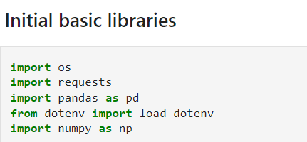
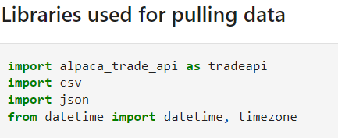
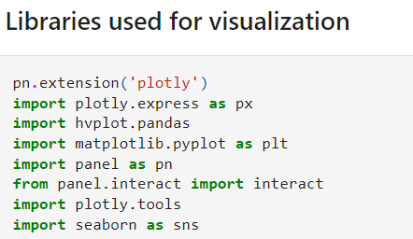
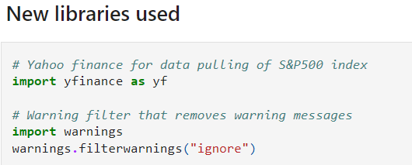
Libraries used

Slide 6
Data Cleanup & Exploration
Group described the data exploration and clean-up process (accompanied by Jupyter Notebook).…..
Exploration & Clean-up
Problems & Insight
Interesting Findings
We each began with data from yahoo finance, and we removed null values, duplicates and sorted the data.
Initially we did had some problems…………..
We found that……………

Slide 7
